Slide 1
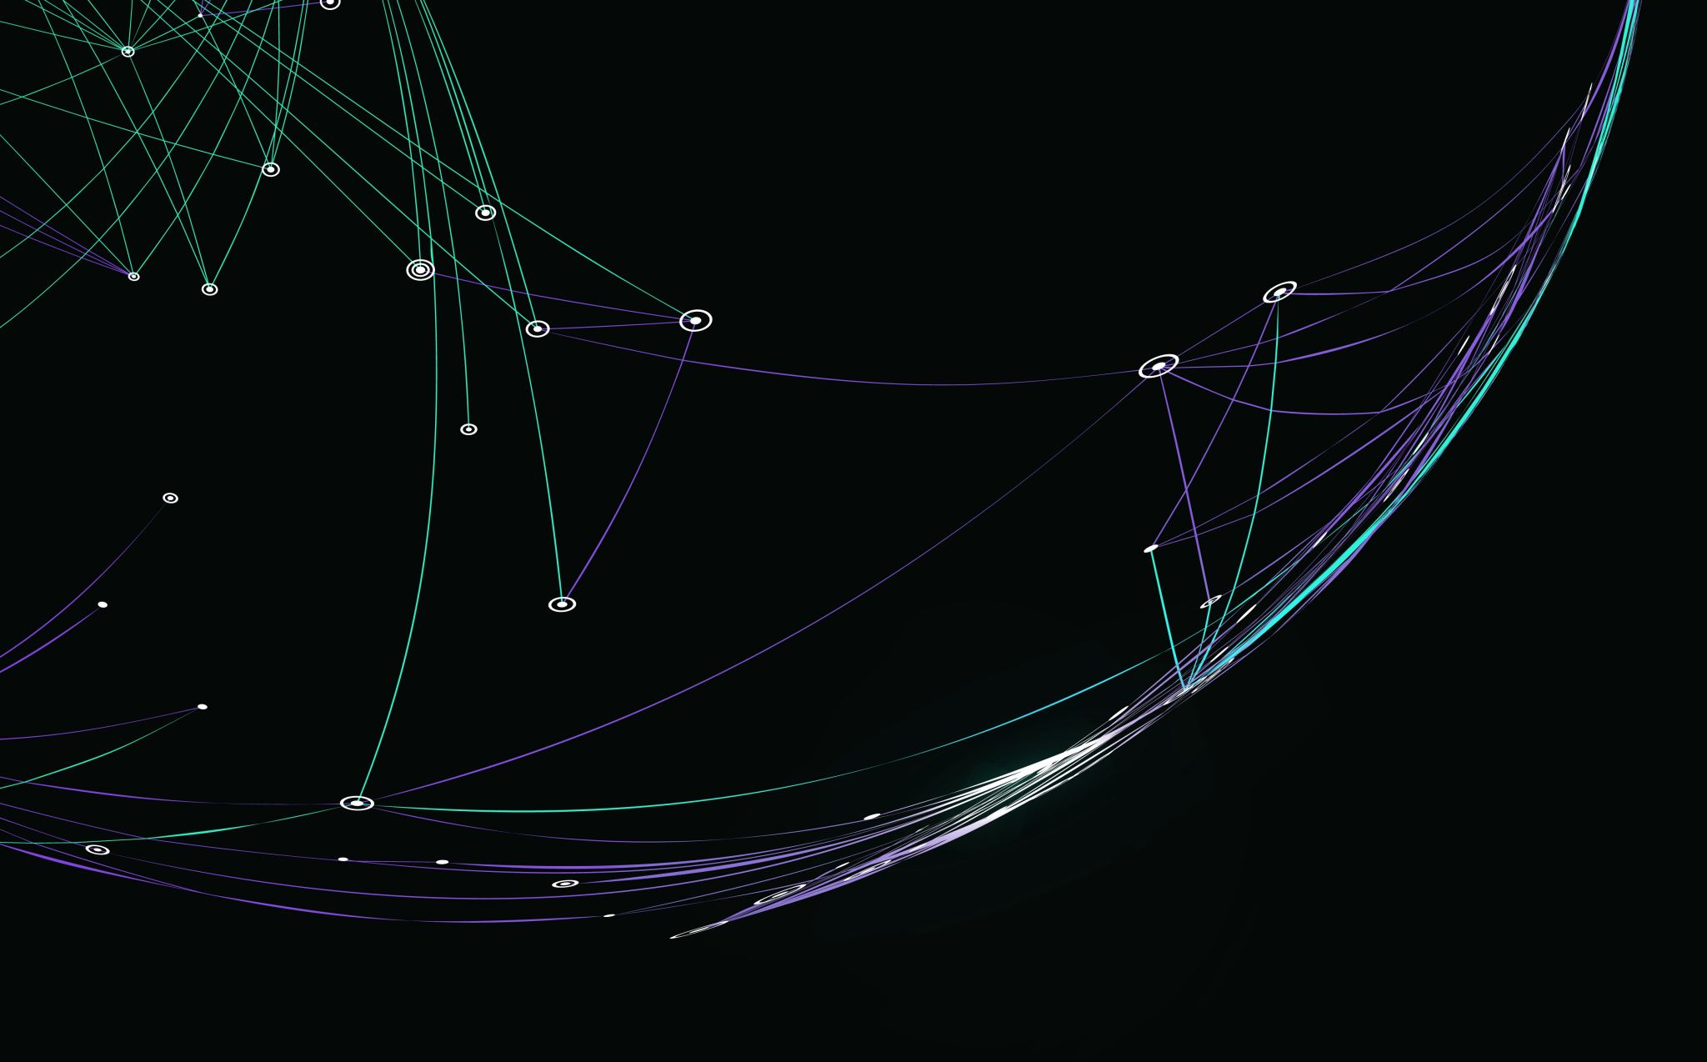
Path-Planning and Path Tracking of a Mobile Robot
By Anirban Barua (100920756)

Slide 2
Introduction
Path planning and path tracking are fundamental concepts in the field of robotics, particularly in the domain of autonomous navigation.
Importance:
Path planning and tracking enable robots to autonomously navigate through different environments, completing tasks efficiently and safely.
Effective path planning can help optimize the robot's trajectory, minimizing travel time and energy consumption. Path tracking ensures that the robot follows the planned path as closely as possible, further enhancing efficiency.
These techniques are essential for a wide range of robotic applications, including autonomous vehicles, mobile robots in warehouses, drones for delivery or surveillance, robotic exploration in unknown environments, and more.

Slide 3
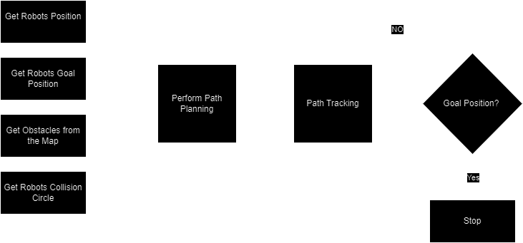
Simulation Flow CHART
Path Planning Algorithm: Bi-RRT and RRT
Path Tracking Algorithm: Follow the Carrot

Slide 4
RRT (Rapidly Exploring Random Tree) algorithm
Initial tree that started from the start node in a state space.
Expansion:
Randomly sample a node from the state space.
Find the nearest node in the existing tree to the sampled node.
Create another node Xnew between X rand and Xnear to expand the tree.
If the random node is in the obstacle, its not created.
Repeat the expansion step until the tree reaching the goal node or a maximum number of iterations is reached.
Construct a path from the initial node to the goal node by backtracking through the tree.
Obstacle
Xstart
Xrand
Xnear
Xnew
Xgoal
State Space

Slide 5
Bi-RRT (Bidirectional Rapidly Exploring Random Tree) algorithm
Initialize two trees, one rooted at the start node and the other rooted at the goal node.
Iteratively grow both trees towards random nodes in the space.
Connect the trees if a new node added to one tree is within a certain distance threshold of a node of the other tree.
Once the trees meet, construct a path by backtracking from the start node to the common node, and then from the common node to the goal node.
Obstacle
Xstart
Xnew
Xnew
Connect
Xgoal
State Space

Slide 6
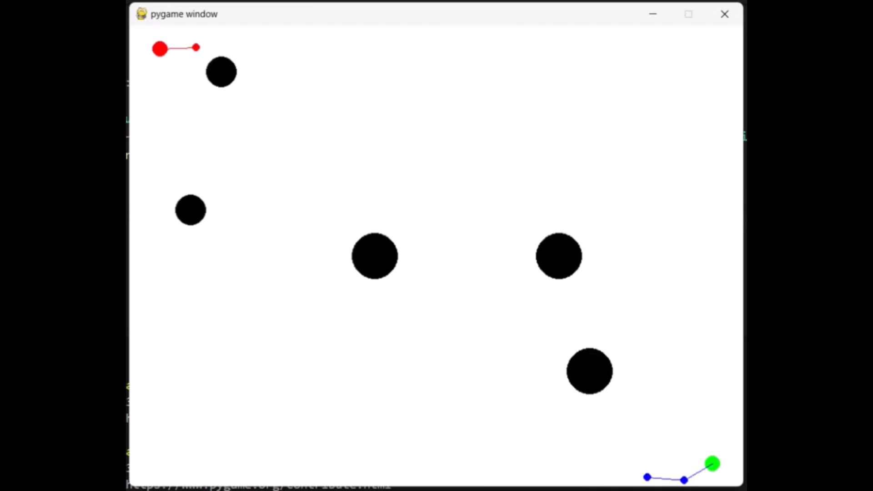
bI-RRT animation
ITERATION - 100

Slide 7
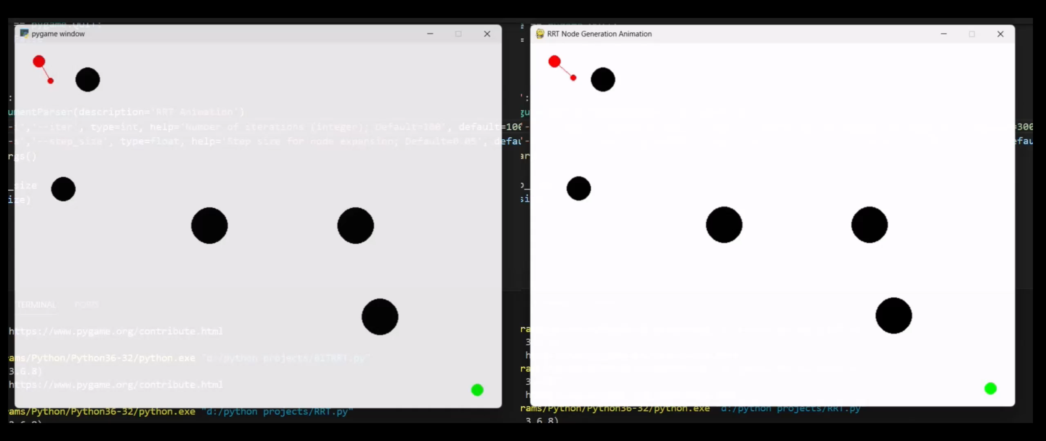
Rrt ANIMATION
ITERATION - 100
ITERATION - 300

Slide 8
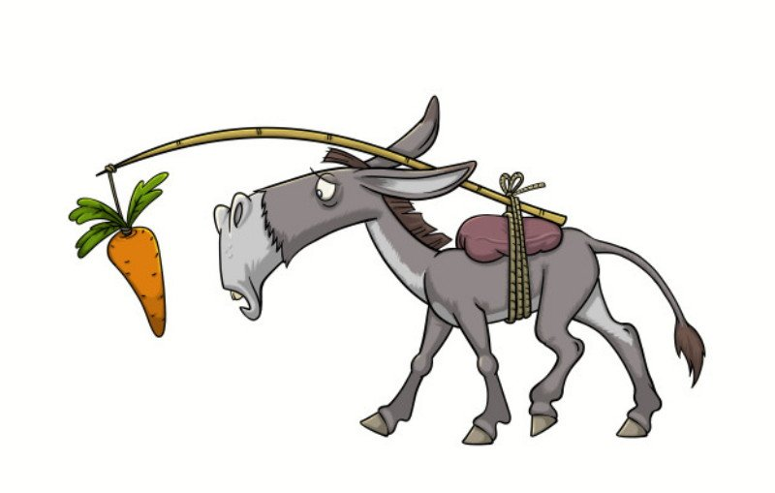
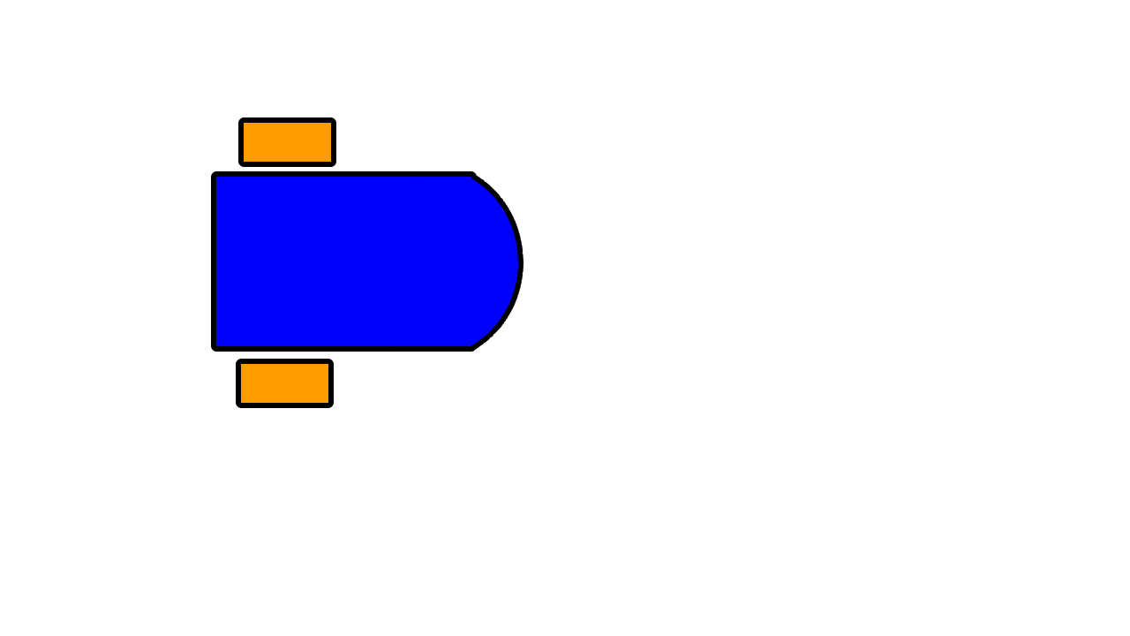
Follow the carrot
Get a closest position (P) on the path relative to robot's front reference point (X).
Compute the point P coordinates relative to the robot's reference frame.
Distance error (L) and orientation error (β)
The robot will start moving using the following equations:
Vright= (1.0+kp* β)
Vleft= (1.0-kp* β)
When the Distance error (L) is equal to the certain distance threshold or close to point P, the algorithm will create another point on the path.
This process will continue until the robot reaches the goal node.
[Peakd.com]
X
P
L

Slide 9
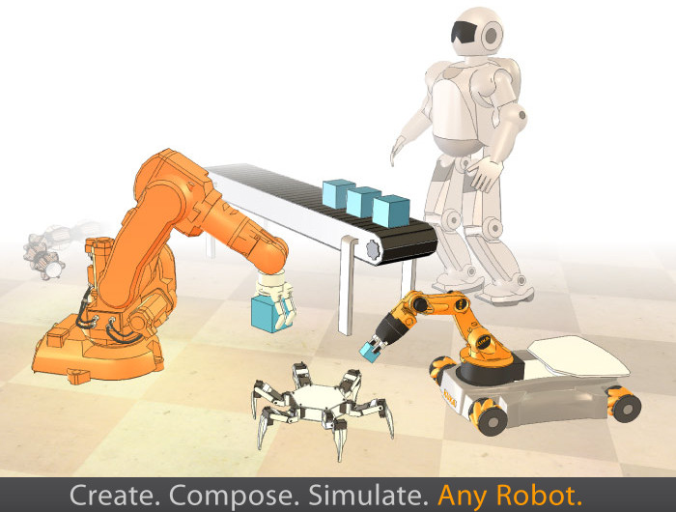

Simulation software
CoppeliaSim is a robotics simulator with an integrated development environment.
Each object/model can be individually controlled via an embedded script, a plugin, ROS / ROS2 nodes, remote API clients, or a custom solution.
Controllers can be written in C/C++, Python, Java, Lua, Matlab or Octave.

Slide 10
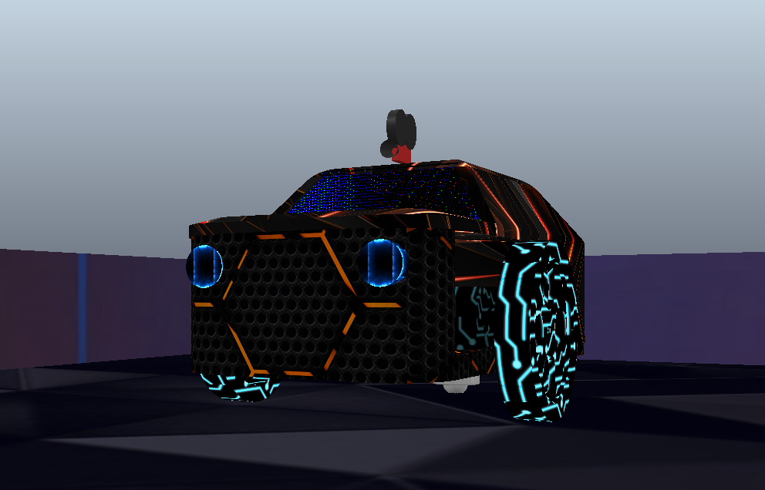
Simulation Robot

Slide 11
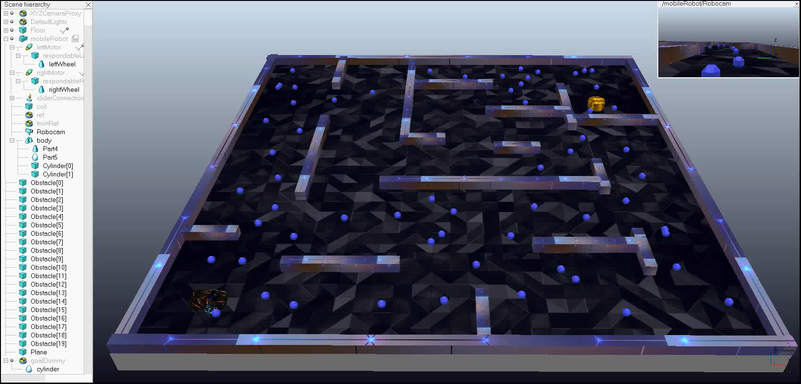
BI-RRT Simulation

Slide 12
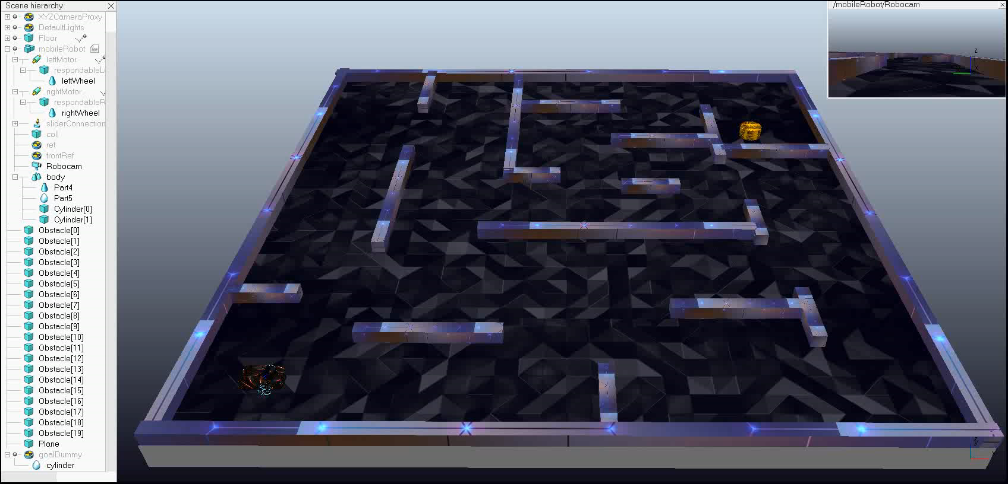
RRT Simulation (Same Search Duration)

Slide 13
RRT Simulation (Increased Search Duration)

Slide 14
Thank You

